Slide 1
EAP Writing Assessment
Preparation Mini-Unit

Slide 2
The EAP Overview
Reason:
Based on CA Standards Tests & CSU placement exam scores, 60% of high school students admitted into the CSU are not prepared for college level math or English. All of these students participated in their school’s college prep curriculum and collectively averaged a “B” high school G.P.A.
Goals:
California high school graduates will enter the CSU fully prepared for college level English and math.

Slide 3
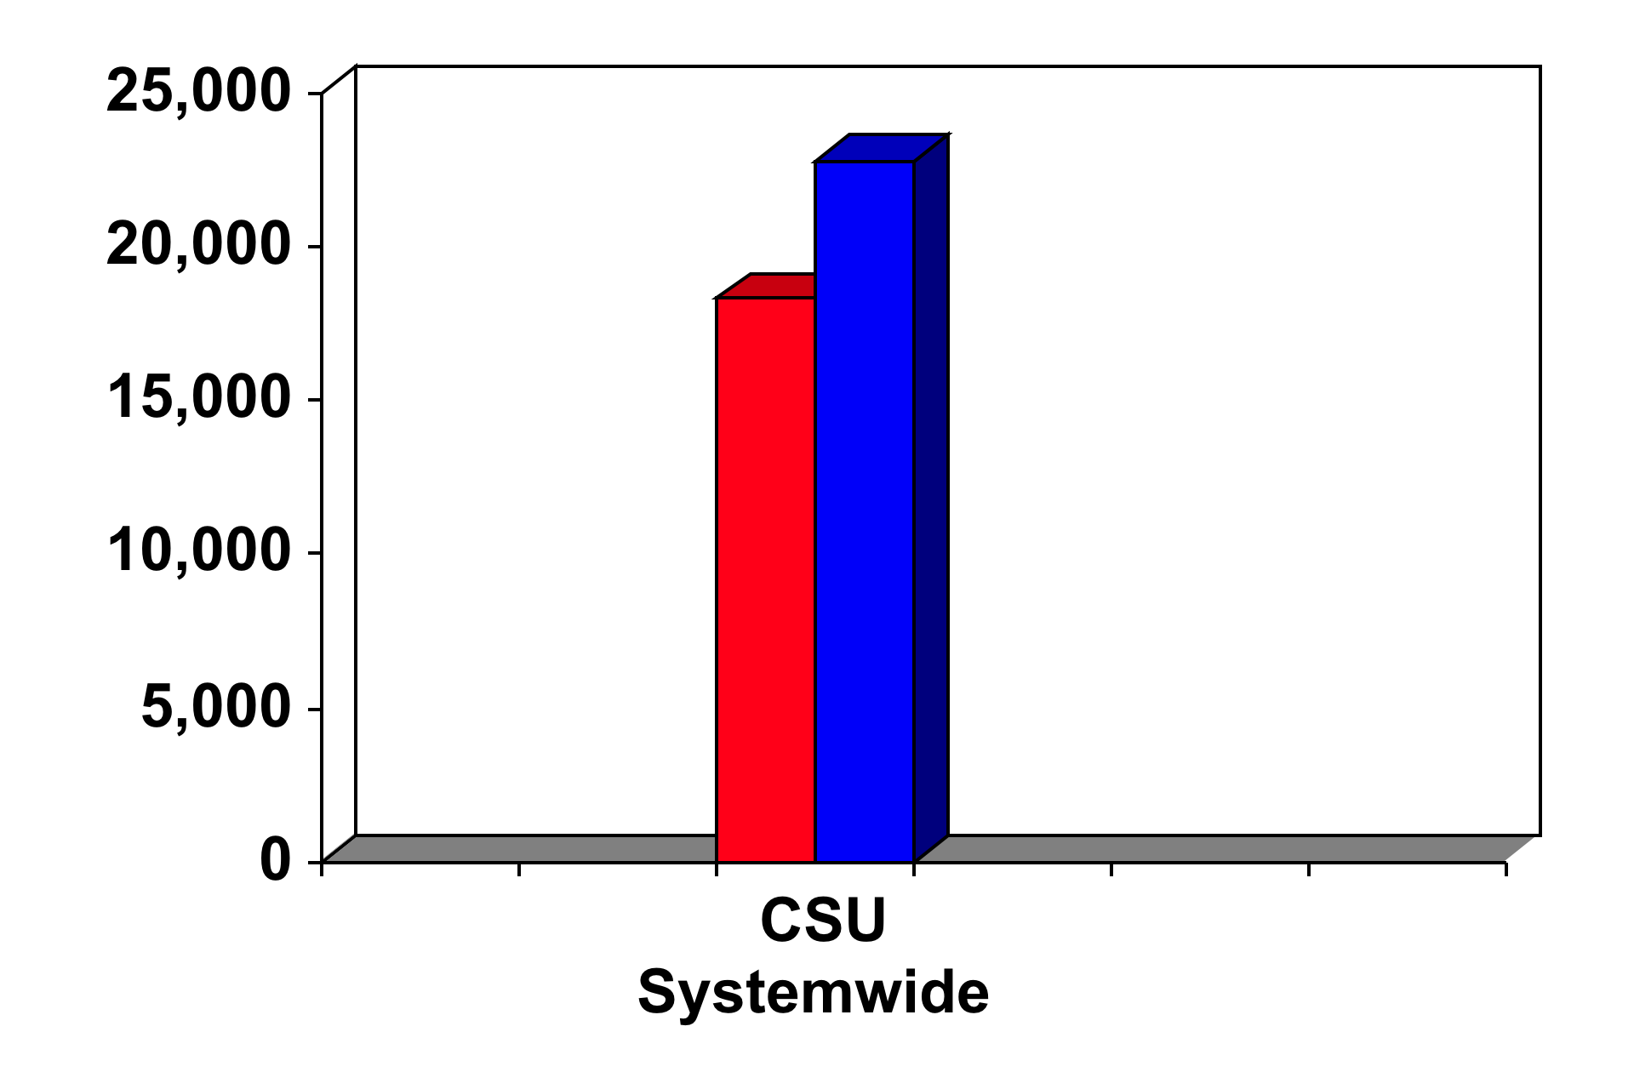
Number of 1st Time Freshmen Entering CSU needing remediation in English and math
22,766
18,320
Math Remediation
English Remediation

Slide 4
EAP Timeline
March: Students sit for the EAP English essay.
April: Students take the CST + EAP question portion.
Summer: ETS scores the exams.
August: ETS delivers EAP results to district offices.
Then: Districts mail STAR (CST) student reports to students’ homes. One copy stays in students’ files at school.

Slide 5
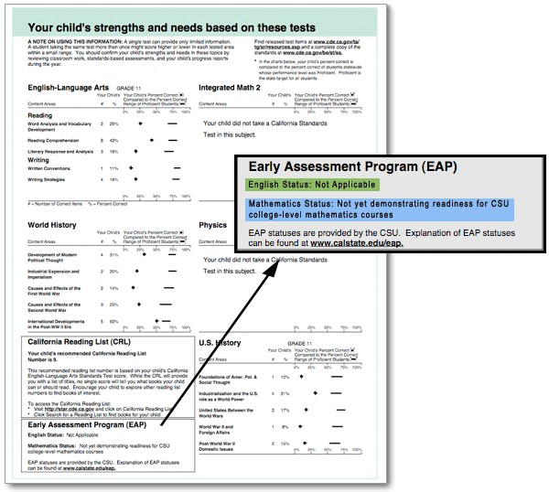
Example of STAR CST Report
Look for your EAP results this summer.
They will either say “demonstrating readiness” if you pass or
“not yet demonstrating readiness” if not

Slide 6
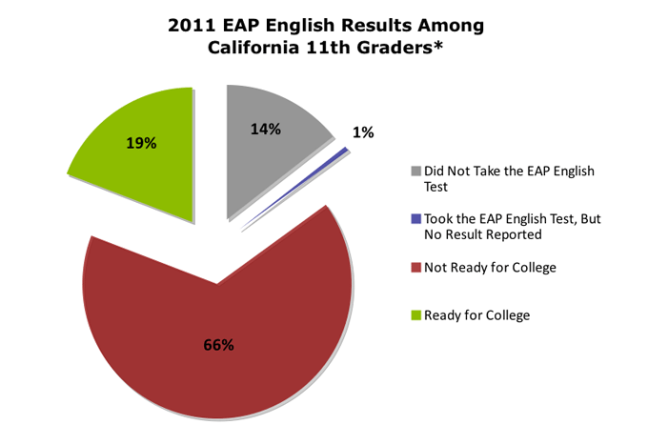

Slide 7
Sadly, the results of the EAP in CA have not been spectacular the last few years.
Over the next 2 weeks we will look at EAP released prompts, sample essays, and practice responding ourselves to ensure that 100% of my students are ready to kick some EAP booty.

Slide 8
Looking at the Criteria
All EAP/EPT assessments are scored on rubric with score levels 1-6.
Score level 6 – Superior
Score level 5 – Strong
Score level 4 – Adequate
Score level 3 – Marginal
Score level 2 – Weak
Score level 1 – Very Weak
Passing Scores
Failing Scores

Slide 9
Looking at the Criteria
Your goal should be to score in the Superior level 6 on the rubric. Remember – always aim high!!
Working with your partner, look at the language used to describe the 6 different areas on the rubric under the “Superior level 6”.
For each area of the rubric under level 6, discuss with your partner what you must do as the writer.
→ What will the scorer be looking for in your essay for this score level?
Then, look at the language used in some of the lower score levels in that criteria area.
→ What makes the difference between a passing/failing score?
Finally, write what you must do as the writer in your own words on the handout provided.

Slide 10
Looking at the Criteria
Example for first area of criteria:
Response to the Topic (level 6): addresses the topic clearly and responds effectively to all aspects of the prompt
Other levels: What language stands out? What do we know we must AVOID in order to succeed?
In other words:
I must clearly focus on the GIVEN topic and respond to ALL instructions given in the prompt.

Slide 11
Looking at the Criteria
Your goal should be to score in the Superior level 6 on the rubric. Remember – always aim high!!
Working with your partner, look at the language used to describe the 6 different areas on the rubric under the “Superior level 6”.
For each area of the rubric under level 6, discuss with your partner what you must do as the writer.
→ What will the scorer be looking for in your essay for this score level?
Then, look at the language used in some of the lower score levels in that criteria area.
→ What makes the difference between a passing/failing score?
Finally, write what you must do as the writer in your own words on the handout provided.

Slide 12
WHAT R.I.S. Means…. What we must do as the writer
Each writing prompt does the following:
Asks you to Recap the topic or provided text
Invites you to share your opinion on that topic
Requires you to stipulate your opinion with evidence
In response to the R.I.S. demands in each prompt, as the writer you must:
Recap the topic or provided text
Share your opinion, state an argument for/against an issue ….in other words – WRITE A THESIS STATEMENT
Provide evidence to support your opinion/arguments/points – from the text, other knowledge, personal experiences, or observations.

Slide 13
“Marie Winn” Writing Prompt
The self-confessed television addict often feels he “ought” to do other things—but the fact that he doesn’t read and doesn’t plant his garden or sew or crochet or play games or have conversations means that those activities are no longer as desirable as television viewing. In a way, a heavy viewer’s life is as imbalanced by his television “habit” as a drug addict’s or an alcoholic’s. He is living in a holding pattern, as it were, passing up the activities that lead to growth or development or a sense of accomplishment. This is one reason people talk about their television viewing so ruefully, so apologetically. They are aware that it is an unproductive experience, that almost any other endeavor is more worthwhile by any human measure.
-Marie Winn
Explain Winn’s argument and discuss the extent to which you agree or disagree with her analysis. Support your position, providing reasons and examples from your own experience, observations, or reading.

Slide 14
“Marie Winn” Writing Prompt
The self-confessed television addict often feels he “ought” to do other things—but the fact that he doesn’t read and doesn’t plant his garden or sew or crochet or play games or have conversations means that those activities are no longer as desirable as television viewing. In a way, a heavy viewer’s life is as imbalanced by his television “habit” as a drug addict’s or an alcoholic’s. He is living in a holding pattern, as it were, passing up the activities that lead to growth or development or a sense of accomplishment. This is one reason people talk about their television viewing so ruefully, so apologetically. They are aware that it is an unproductive experience, that almost any other endeavor is more worthwhile by any human measure.
-Marie Winn
Explain Winn’s argument and discuss the extent to which you agree or disagree with her analysis. Support your position, providing reasons and examples from your own experience, observations, or reading.
Read the writing prompt again.
Label R.I.S. within the prompt.

Slide 15
“Marie Winn” Writing Prompt
The self-confessed television addict often feels he “ought” to do other things—but the fact that he doesn’t read and doesn’t plant his garden or sew or crochet or play games or have conversations means that those activities are no longer as desirable as television viewing. In a way, a heavy viewer’s life is as imbalanced by his television “habit” as a drug addict’s or an alcoholic’s. He is living in a holding pattern, as it were, passing up the activities that lead to growth or development or a sense of accomplishment. This is one reason people talk about their television viewing so ruefully, so apologetically. They are aware that it is an unproductive experience, that almost any other endeavor is more worthwhile by any human measure.
-Marie Winn
Explain Winn’s argument and discuss the extent to which you agree or disagree with her analysis. Support your position, providing reasons and examples from your own experience, observations, or reading.
Complete the R.I.S. worksheet based on the demands of the prompt.

Slide 16
10 - minute Mini Essay (and I mean mini) in response to Winn Excerpt
Write a one-two paragraph mini essay in response to the Marie Winn excerpt and writing prompt.
In your mini-essay be sure to:
Hook the reader into the topic
Recap the topic (name the author of the excerpt in your recap!)
Provide your personal opinion & reasoning (THESIS)
Stipulate your thesis with evidence (1-2 examples) that helps prove/illustrate your point. (connect your examples back to your thesis)
This is a quick version of what you will do for a real EAP response. The purpose of this practice is to come up with an argument in response to a given topic under the pressure of time constraints. GO SCRIVNERS, GO!

Slide 17
“Irving Coffman” Writing Prompt
Recently, major tobacco companies agreed to pay a financial settlement to several states, including California, for health problems caused by cigarette smoking and other kinds of tobacco addiction. If this course of action is right for tobacco companies, then manufacturers of other legal but harmful products such as alcohol and guns should also have to pay financial settlements in return for the problems they cause.
-Irving Coffman
Explain Coffman's argument and discuss the extent to which you agree or disagree with his analysis. Support your position, providing reasons and examples from your own experience, observations, or reading.
* Label R.I.S. in the writing prompt

Slide 18
“Irving Coffman” Writing Prompt
Recently, major tobacco companies agreed to pay a financial settlement to several states, including California, for health problems caused by cigarette smoking and other kinds of tobacco addiction. If this course of action is right for tobacco companies, then manufacturers of other legal but harmful products such as alcohol and guns should also have to pay financial settlements in return for the problems they cause.
-Irving Coffman
**Complete the Recap activity on your handout.

Slide 19
Scoring Criteria: review
A 6 essay is superior writing, but may have minor flaws. A typical essay in this category:
addresses the topic clearly and responds effectively to all aspects of the task
demonstrates a thorough critical understanding of the passage in developing an insightful response
explores the issues thoughtfully and in depth
is coherently organized and developed, with ideas supported by apt reasons and well-chosen examples
has an effective, fluent style marked by syntactic variety and a clear command of language
is generally free from errors in grammar, usage, and mechanics

Slide 20
Sample Essay: In response to Coffman Excerpt & Writing Prompt
You are going to read an actual student response to a EAP/EPT writing prompt.
This essay was scored by two individual scorers, and was awarded a “Superior level 6” score by both scorers.
Read the essay with your partner. After each paragraph, stop to discuss it’s strengths.
Highlight & label when you find level 6 criteria being met in the essay, as well as when/where the writer is responding the R.I.S. from the prompt.
Be ready to share your analysis of the essay with the class.

Slide 21
EAP Journal Warm-up: 3/7/13
How do you define “success”? What makes a person successful? What makes a person unsuccessful? (think of more than work/career - relationships, friendships, goals, personal satisfaction, charity, etc)
In what ways (think of several!) do people respond to other people’s success?

Slide 22
“Margaret Mead” Writing Prompt
For many Americans, the concept of success is a source of confusion. As a people, we Americans greatly prize success. We are taught to celebrate and admire the one who gets the highest grades, the one voted most attractive or most likely to succeed. But while we often rejoice in the success of people far removed from ourselves—people who work in another profession, live in another community, or are endowed with a talent that we do not especially want for ourselves—we tend to regard the success of people close at hand, within our own small group, as a threat.”
- Margaret Mead, from The Egalitarian Error
Explain Mead’s argument and discuss the extent to which you agree or disagree with her analysis. Support your position, providing reasons and examples from your own experience, observations, or reading.
*Label R.I.S. in the prompt

Slide 23
“Margaret Mead” Writing Prompt
For many Americans, the concept of success is a source of confusion. As a people, we Americans greatly prize success. We are taught to celebrate and admire the one who gets the highest grades, the one voted most attractive or most likely to succeed. But while we often rejoice in the success of people far removed from ourselves—people who work in another profession, live in another community, or are endowed with a talent that we do not especially want for ourselves—we tend to regard the success of people close at hand, within our own small group, as a threat.”
- Margaret Mead, from The Egalitarian Error
**Complete the Recap activity on your handout.

Slide 24
Scoring Criteria: review
A 6 essay is superior writing, but may have minor flaws. A typical essay in this category:
addresses the topic clearly and responds effectively to all aspects of the task
demonstrates a thorough critical understanding of the passage in developing an insightful response
explores the issues thoughtfully and in depth
is coherently organized and developed, with ideas supported by apt reasons and well-chosen examples
has an effective, fluent style marked by syntactic variety and a clear command of language
is generally free from errors in grammar, usage, and mechanics

Slide 25
Sample Essay: In response to MEAD Excerpt & Writing Prompt
You are going to read an actual student response to a EAP/EPT writing prompt.
This essay was scored by two individual scorers, and was awarded a “Superior level 6” score by both scorers.
Read the essay with your partner. After each paragraph, stop to discuss it’s strengths.
Highlight & label when you find level 6 criteria being met in the essay, as well as when/where the writer is responding the R.I.S. from the prompt.
Be ready to share your analysis of the essay with the class.

Slide 26
Sample Essay: In response to MEAD Excerpt & Writing Prompt
You are going to read two additional student responses to the Margarat Mead excerpt and prompt.
It will be your job to determine how each of these essays should be scored using the EPT rubric.
Read the essay with your partner. After each paragraph, stop to discuss it’s strengths & weaknesses.
Highlight when you find the rubric criteria & determine what level you think it is meeting,
Also, highlight when/where the writer is responding to R.I.S. from the prompt.
Be ready to share your analysis of the essay with the class.

Slide 27
Writing Task Now it’s your turn
You are going to read 4 additional EAP sample prompts.
For each text excerpt, you will write a quick recap of what the author is trying to convince you of.
Then, you will choose one of the prompts and write a complete EAP acceptable response.
This essay is worth 30 points & will be scored on the EAP/EPT rubric.

Slide 28
Practice EAP
You have one hour to write an essay in response to one of the 4 EAP sample prompts.
This essay is worth 36 points & will be scored on the EAP/EPT rubric.

Slide 29
Practice EAP – Peer Score
You are going to receive a random peer EAP response.
Your job is to read the essay, and highlight where it does the following:
Recaps the author’s main argument & the general topic
Shares his/her own argument (thesis statement)
Gives examples/evidence to stipulate that argument (personal experience, other readings, observations, etc.)
Write comments/suggestions on the rubric to show why you assigned it that score.

