Slide 1
To choose or not to choose, that's the question.
Linh Ho
Josue Valentin
Theory of Knowledge
Mr. Coey

Slide 2
Introduction
About 4,300,000 people in the US consider themselves as Gay, Lesbian or Bisexual. 2 million of them as gay men and about 900,000 are Lesbian women. Homosexuality is a controversial issue both in the social aspect of our families as well as in the political aspect of our country.

Slide 3
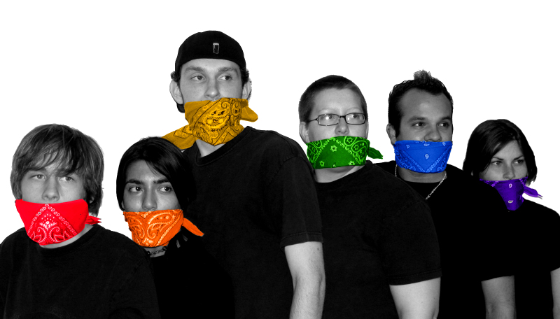
Real Life Situation
Sponsored by GLSEN, the Gay, Lesbian and Straight Education Network.
National Day of Silence day of action in which students across the country vow to be in silence.
" Homosexuality is morally right because it is natural"

Slide 4
Continued...
Day of Dialogue by Focus on the Family .
"It’s not unusual for students to often feel like their deeply held beliefs—including the deepest truths of Christianity—are being mischaracterized. he event gives you, as a student, an opportunity to express the true model presented by Jesus Christ in the Bible."
,"Homosexuality is morally wrong."

Slide 5
Knowledge issue QUestion
What is the process for determining and evaluating morality?

Slide 6
Dissecting the question
Assumptions-
There is a process.
It can be determined and evaluated.
Morality
According to Dictionary.com, it reads, " of, pertaining to, or concerned with the principles or rules of right conduct or the distinction between right and wrong;"

Slide 7
MORALITY IN TOK DICTIONARY!
"SOme people who are sceptical about moral knowledge claim that moral values and judgments are simply matters of taste. But we take values more seriously than tastes and we expect people to justify their value-judgements and support them with reasons." ( Loogemaat, 364)

Slide 8
KNOWLEDGE= JUSTIFED TRUE BELIEFS!

Slide 9
Nature of Beliefs
"Beliefs are a subjective requirement for knowledge." May explain the conflict b/w knowledge communities.
3 kinds of beliefs: a) Vague Belief b) A- well supported belief c) A belief that is beyond reasonable doubt.

Slide 10
Justify it!

Slide 11
Justification of moral beliefs from different perspectives
Religous Perspective
"I feel that whatever they are that's them. I am not judging."- Moral relativism.
Religious ethics.
Emotion

Slide 12
Moral Relativism
Values determine by the society we grow up.
Customs or conventions that vary from culture.
"Some people drive on the left others on the right"

Slide 13
Moral Relativism
Strengths
Diversity Argument- Diversity= no objective morals.
Lack of Foundations- "ungrounded," " no moral reality" in which to test our values.
Weaknesses
There are core values.- limit violence, promote honesty and protect property.
We can justify our values. ei. inflicting needles pain in other is intuitively obvious.
May lead to Nahilism.

Slide 14
RELIGIOUS ETHICS
Simplest approach to ethics would be to find a authoritative rule book which told us what morals to value. Some people thinks that these books found in religion.

Slide 15
Religious ethics
Strengths
World's greatest religions are important sources of moral insight.
Based on some empirical evidence.
Weaknesses
Have the responsibility to decide which sacred texts to follow. (Christianity vs.Buddhist )
Plato's Question- Values are independent of God.

Slide 16
Emotion
Are connected to our beliefs.
We focus in intuition
"AHa" moment of insight.
"Our sixth." sense that hunches us.

Slide 17
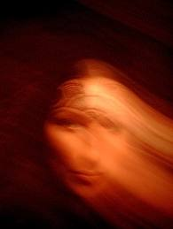
Intuition ( continued...)
Three types:
Core intuition: fundamental intuition about life, the universe and everything.
Subject-Specific intuitions: Intuitions we have in areas of knowledge.
Social Intuitions: About other people, (can people be trusted?)

Slide 18
Subject- Based Intuition
"Used this intuition to justify knowledge claims in various areas of knowledge."

Slide 19
SUbject- Specific intuitions
Strengths
Used to justify knowledge claims.
Can be tested with other sources of knowledge= more certain intuition.
Weaknesses Our intuitions change.
Uneducated Intuitions

Slide 20
glBT perspective
Ways they justify their beliefs.
Kant's approach to ethics
Emotion
Scientific Evidence

Slide 21
Kant's approach to ethics
We should have a dual conception of me, and among others.
Generalize it
Golden Rule

Slide 22
Value and dignity
Dual conception = no one should be be given preferential treatment.
Also no one should be discriminated against.
Difference between objects and persons is that objects have value, but only humans can have dignity,

Slide 23
Criticisms of kant's approach
It's too absolutist = moral absolutism.
You should not always follow a moral principal.

Slide 24
Emotion
Are connected to our beliefs.
We focus in intuition
"AHa" moment of insight.
"Our sixth." sense that hunches us.

Slide 25
Intuition ( continued...)
Three types:
Core intuition: fundamental intuition about life, the universe and everything.
Subject-Specific intuitions: Intuitions we have in areas ok knowledge.
Social Intuitions: About other people, (can people be trusted?)

Slide 26
Subject- Based Intuition
"Used this intuition to justify knowledge claims in various areas of knowledge."
Innate conscience- We are born with our moral principles.

Slide 27
SUbject- Specific intuitions
Strengths
Used to justify knowledge claims.
Can be tested with other sources of knowledge= more certain intuition.
Weaknesses Our intuitions change.
Uneducated Intuitions

Slide 28
Scientific Evidence
Nicholas Wade, scientific reporter.
2007 New York Times Article.
"Straight men, it seems, have neural circuits that prompt them to seek out women; gay men have those prompting them to seek other men."
" Studies of twins show that homosexuality, especially among men, is quite heritable, meaning there is a genetic component to it."

Slide 29
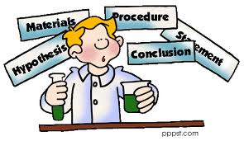
Science as an area of knowledge
Basic Scientific Method
Falsification

Slide 30
Scientific Method
Although the basic scientific method provides with a straightforward procedure to generate scientific truth,it's self-corrected and communal, we have to be aware of problems in observation, and testing our hypothesis.
Expectations
Observer effect
Confirmation Bias.
Conscience Bias

Slide 31
Falsification
Even though falsification may lead to greater certainty because we only need one counter-example to disclaim a theory, in practice we don't.
reject hypothesis
reject observation
accept both hypothesis and observation and make a auxiliary option.

Slide 32
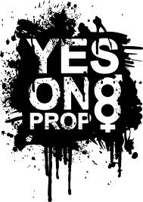
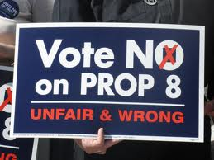
WHy does it even matter?

Slide 33
Linking question
How does language shape our interpretation of moral beliefs?

Slide 34
Difference in interpretation!
Christian Apologetics and Research Ministry
Gay Christian 101
Lev. 18:22, "You shall not lie with a male as one lies with a female; it is an abomination.
Lev. 20:13, "If there is a man who lies with a male as those who lie with a woman, both of them have committed a detestable act; they shall surely be put to death. Their bloodguiltness is upon them"
Homosexuality is clearly condemned by the Bible. It goes against the created order of God
“If a man also lie with mankind, as he lieth with a woman, both of them have committed an abomination [towebah]: they shall surely be put to death; their blood shall be upon them.” Leviticus 20:30
In the twenty first century many Christians confuse modern homosexuality, a committed, faithful, noncultic same sex partnership, with the ancient world’s sexual abuse of slaves, pederasty, rape of foreigners and pagan fertility rites. None of those ancient practices are analogs to modern homosexuality.”

Slide 35
language in Science
Background
Analysis
Conclusion
Limited to the words of the scientists. His lack of language language or our lack of scientific language may influence our thinking of what is a morality.

Slide 36
Sapir-worf hypothesis
Language determines our reality and the way we think.
We can think only what our language allows us.
1984 example
Morality = black and white situation

Slide 37
Criticisms
People are not convinced
The other way around, reality determines language.

Slide 38
Language and values
Emotional laden language
Weasel words- "many" "should". Easy way out.
Grammar.

Slide 39
Conclusion
Since we face ethical dilemmas in the course of our lives, we can't escape having to decide what's morally correct or not. We saw the different sources of moral judgement people adhere to in order to justify their beliefs about morality. While it may seem that the knowledge issue of morality is a relative one, we can all agree that there are some core values in humanity. These core values are perhaps the place to start in determining what is morally correct. We need to be aware, however, of the influence language has in our thinking about moral values so we can make the best decision for us and humanity.

Slide 40
Citations
Brentlinger, RIck. "Homosexuality Wrong? What Does The Bible Really Say About This Important Questio." Gay Christian 101 - Affirming God's good news and Bible truth for all GLBTs. 5 Apr. 2011 <http://www.gaychristian101.com/Homosexuality-Wrong.html>.
"Composite U.S. Demographics." World Religions Religion Statistics Geography Church Statistics. 13 Mar. 2001. 07 Apr. 2011 <http://www.adherents.com/adh_dem.html>.
Slick, Matt. "What does the Bible say about homosexuality? | Christian Apologetics and Research Ministry." CARM - Christian Apologetics and Research Ministry. 5 Apr. 2011 <http://carm.org/homosexuality>.
Van de Lagemort, Richard. Theory of Knowledge. Cambridge: Cambridge UP, 2005.
Wade, Nicholas. "Pas de Deux of Sexuality Is Written in the Genes." New York Times. 7 Apr. 2007. 5 Apr. 2011 <http://www.nytimes.com/2007/04/10/health/10gene.html?pagewanted=1&_r=2&ei=5070&en=b8ee8ae30451c2e9&ex=1187236800>.

